Slide 1



Activation Functions
Indian Institute of Information Technology, Allahabad
By
Dr. Shiv Ram Dubey Assistant Professor Computer Vision And Biometrics Lab (CVBL) Department Of Information Technology Indian Institute Of Information Technology, Allahabad
Email: srdubey@iiita.ac.in Web: https://profile.iiita.ac.in/srdubey/

Slide 2
Disclaimer
The content (text, image, and graphics) used in this slide are adopted from many sources for academic purposes. Broadly, the sources have been given due credit appropriately. However, there is a chance of missing out some original primary sources. The authors of this material do not claim any copyright of such material.

Slide 3
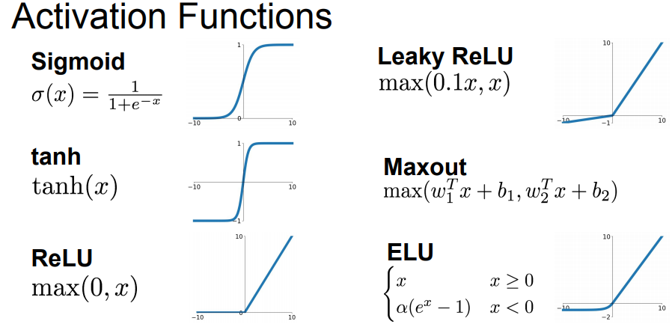
Non-linearity Layer
Source: cs231n, Stanford University

Slide 4
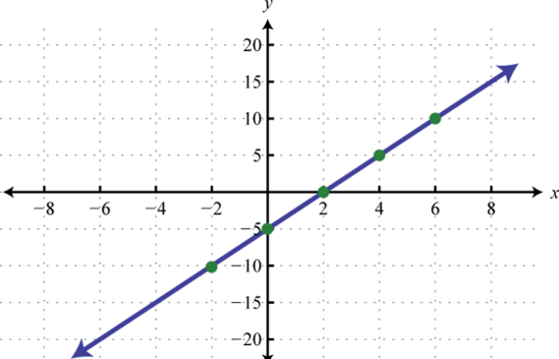
Activation Functions: Linear
Simplest activation function
Does not include any non-linearity.

Slide 5
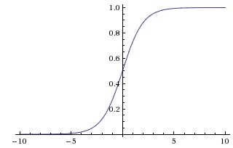

Activation Functions: Sigmoid
Source: cs231n, Stanford University

Slide 6
Activation Functions: Sigmoid
Sigmoids saturate and kill gradients.
Source: cs231n, Stanford University

Slide 7
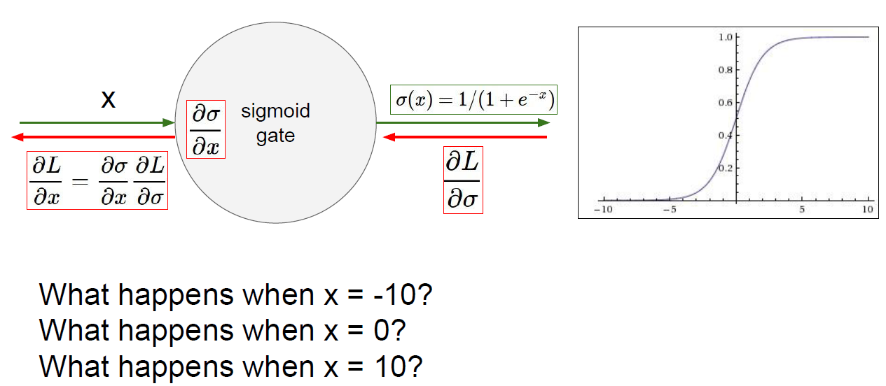
Activation Functions: Sigmoid
Source: cs231n, Stanford University

Slide 8
Activation Functions: Sigmoid
Sigmoids saturate and kill gradients.
Sigmoid outputs are not zero-centered.
Source: cs231n, Stanford University

Slide 9
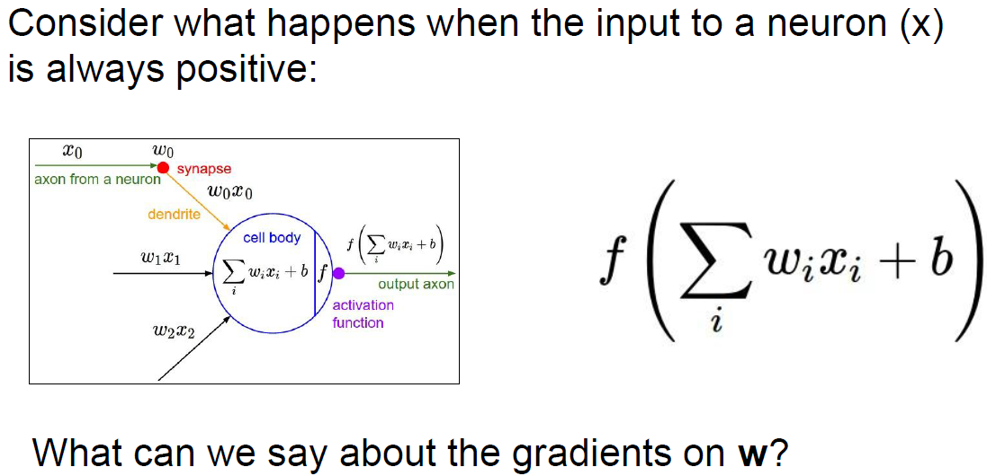
Activation Functions: Sigmoid
Activation Functions: Sigmoid
Always all positive or all negative
(this is also why you want zero-mean data!)
Source: cs231n, Stanford University

Slide 10
Activation Functions: Sigmoid
Always all positive or all negative
(this is also why you want zero-mean data!)
Source: cs231n, Stanford University

Slide 11
Activation Functions: Sigmoid
Sigmoids saturate and kill gradients.
Sigmoid outputs are not zero-centered.
Exp() is a bit compute expensive.
Source: cs231n, Stanford University

Slide 12

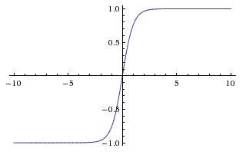

Activation Functions: TANH
[LeCun et al., 1991]
Source: http://cs231n.github.io

Slide 13
Activation Functions: TANH
tanh neuron is simply a scaled sigmoid neuron
Sigmoid
[LeCun et al., 1991]
Source: http://cs231n.github.io

Slide 14
Activation Functions: TANH
tanh neuron is simply a scaled sigmoid neuron
Sigmoid
Like the sigmoid neuron, its activations saturate.
Unlike the sigmoid neuron its output is zero-centered.
In practice the tanh non-linearity is always preferred to the sigmoid nonlinearity.
[LeCun et al., 1991]
Source: http://cs231n.github.io

Slide 15
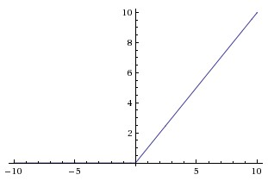

Activation Functions: RELU
[Krizhevsky et al., 2012]
Source: http://cs231n.github.io

Slide 16
Activation Functions: RELU
ReLU is 6 times faster in the convergence of stochastic gradient descent compared to the sigmoid/tanh (Krizhevsky et al.).
ReLU is simple as compared to tanh/sigmoid that involve expensive operations (exponentials, etc.)
[Krizhevsky et al., 2012]
Source: http://cs231n.github.io

Slide 17
Activation Functions: RELU
ReLU is 6 times faster in the convergence of stochastic gradient descent compared to the sigmoid/tanh (Krizhevsky et al.).
ReLU is simple as compared to tanh/sigmoid that involve expensive operations (exponentials, etc.)
Dying ReLU problem: a large gradient flowing through a ReLU neuron could cause the weights to update in such a way that the neuron will never activate on any datapoint again.
[Krizhevsky et al., 2012]
Source: http://cs231n.github.io

Slide 18
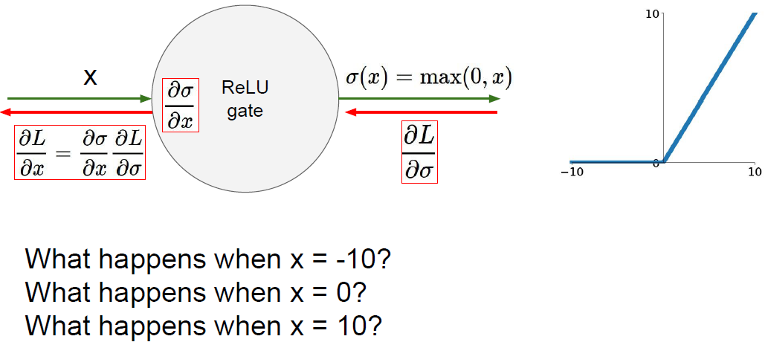
Activation Functions: RELU
Source: cs231n, Stanford University

Slide 19
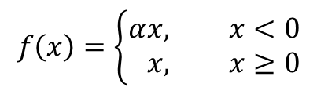

Activation Functions: LEAKY RELU
$$f\left(x\right)=\left\{\begin{aligned}α&x, x<0 \\ &x, x≥0\end{aligned}\right.$$
$$α=0.01$$
[Mass et al., 2013]
Source: http://cs231n.github.io

Slide 20
Activation Functions: LEAKY RELU
$$f\left(x\right)=\left\{\begin{aligned}α&x, x<0 \\ &x, x≥0\end{aligned}\right.$$
$$α=0.01$$
Succeeded in some cases, but the results are not always consistent.
Source: http://cs231n.github.io

Slide 21
Activation Functions: PARAMETRIC RELU
$$f\left(x\right)=\left\{\begin{aligned}α&x, x<0 \\ &x, x≥0\end{aligned}\right.$$
In PReLU, the slope in the negative region is considered as a parameter of each neuron and learnt from data.
He, K., Zhang, X., Ren, S., & Sun, J. (2015). Delving deep into rectifiers: Surpassing human-level performance on imagenet classification. IEEE international conference on computer vision (CVPR).
Source: http://cs231n.github.io

Slide 22

Activation Functions: Maxout
Maxout neuron (introduced by Goodfellow et al.) generalizes the ReLU and its leaky version.
The Maxout neuron computes the function:
[Goodfellow et al., 2013]
Source: http://cs231n.github.io

Slide 23
Activation Functions: Maxout
Maxout neuron (introduced by Goodfellow et al.) generalizes the ReLU and its leaky version.
The Maxout neuron computes the function:
Both ReLU and Leaky ReLU are a special case of this form (for example, for ReLU, we have w1=0,b1=0, w2=identity, and b2=0).
[Goodfellow et al., 2013]
Source: http://cs231n.github.io

Slide 24
Activation Functions: Maxout
Maxout neuron (introduced by Goodfellow et al.) generalizes the ReLU and its leaky version.
The Maxout neuron computes the function:
Both ReLU and Leaky ReLU are a special case of this form (for example, for ReLU, we have w1=0,b1=0, w2=identity, and b2=0).
Unlike the ReLU neurons it doubles the number of parameters.
[Goodfellow et al., 2013]
Source: http://cs231n.github.io

Slide 25
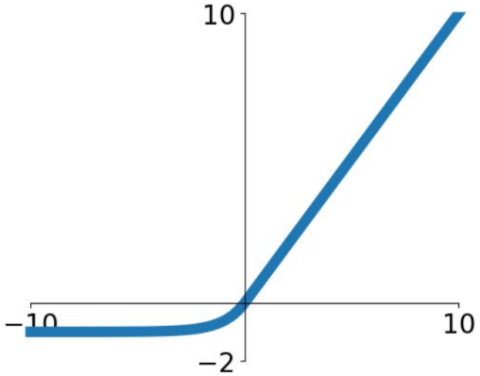
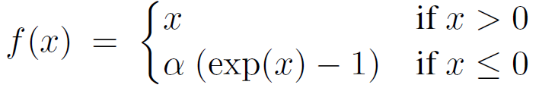
Activation Functions: ELU
Exponential Linear Unit
Clevert, Djork-Arné, Thomas Unterthiner, and Sepp Hochreiter. "Fast and accurate deep network learning by exponential linear units (elus)." International Conference on Learning Representations (ICLR) 2016.

Slide 26
Activation Functions: ELU
Exponential Linear Unit
All benefits of ReLU
Negative saturation regime compared with Leaky ReLU adds some robustness to noise
Computation requires exp()
Clevert, Djork-Arné, Thomas Unterthiner, and Sepp Hochreiter. "Fast and accurate deep network learning by exponential linear units (elus)." International Conference on Learning Representations (ICLR) 2016.

Slide 27
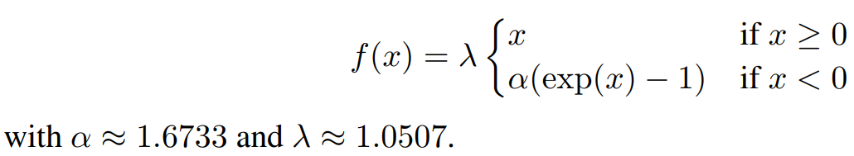
Activation Functions: SELU
Scaled Exponential Linear Unit (SELU)
SELU induces self-normalization to automatically converge towards zero mean and unit variance
Klambauer, Günter, Thomas Unterthiner, Andreas Mayr, and Sepp Hochreiter. "Self-normalizing neural networks." In Advances in Neural Information Processing Systems (NIPS), 2017.

Slide 28
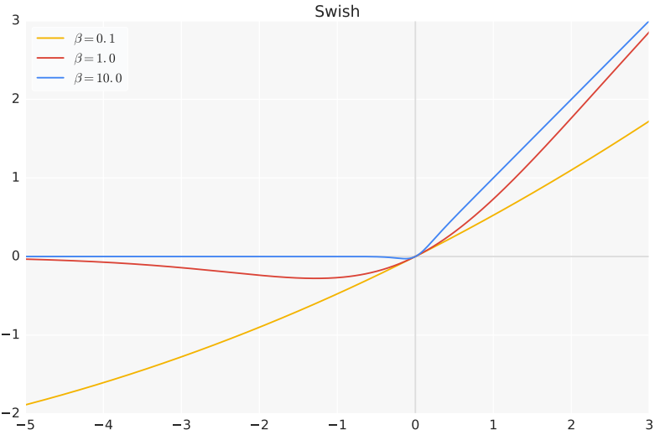

Activation Functions: SWISH
ReLU is special case of Swish
Ramachandran et al. "Swish: a self-gated activation function." ICLR Workshops, 2018.

Slide 29
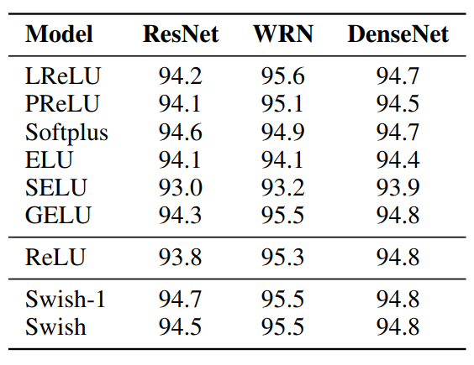
Activation Functions: SWISH
ReLU is special case of Swish
CIFAR-10 accuracy
Ramachandran et al. "Swish: a self-gated activation function." ICLR Workshops, 2018.

Slide 30

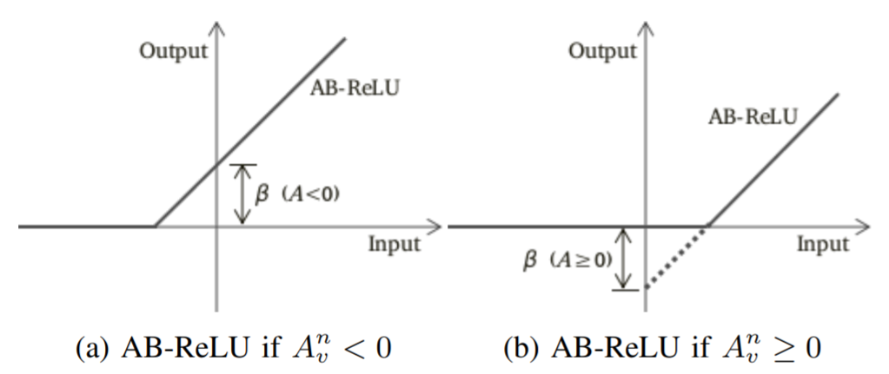
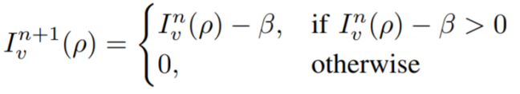

Activation Functions: ABReLU
average of input volume
Average Biased ReLU (ABReLU)
S.R. Dubey and S. Chakraborty (2020). Average Biased ReLU Based CNN Descriptor for Improved Face Retrieval. Multimedia Tools and Applications. (Springer)

Slide 31
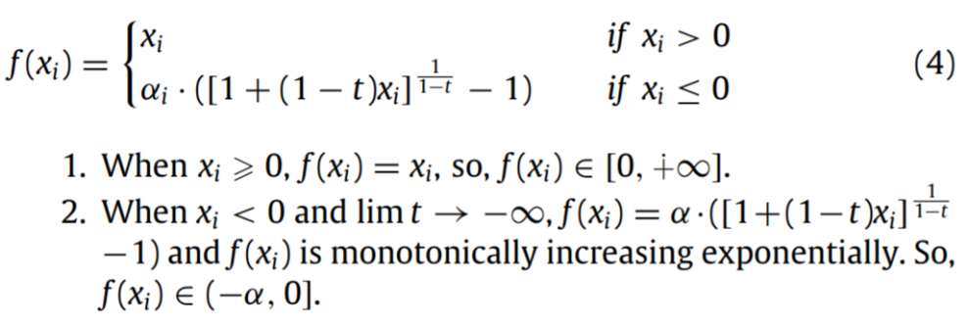
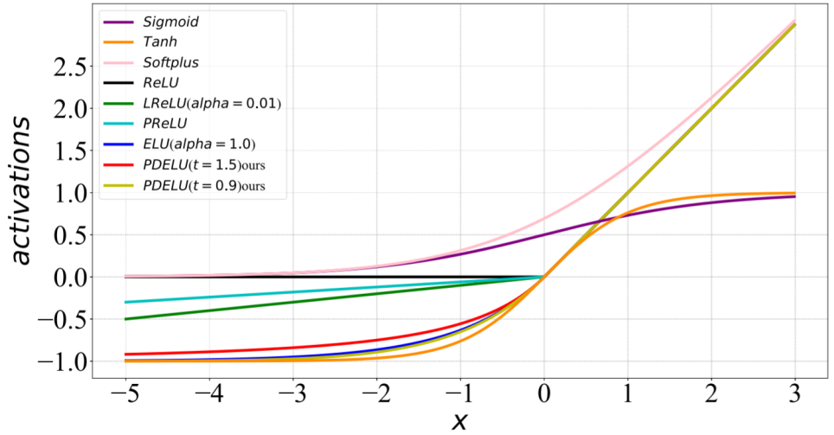
Activation Functions: PDELU
Parametric Deformable Exponential Linear Units (PDELU)
Cheng, Q., Li, H., Wu, Q., Ma, L., & King, N. N. (2020). Parametric Deformable Exponential Linear Units for deep neural networks. Neural Networks.

Slide 32
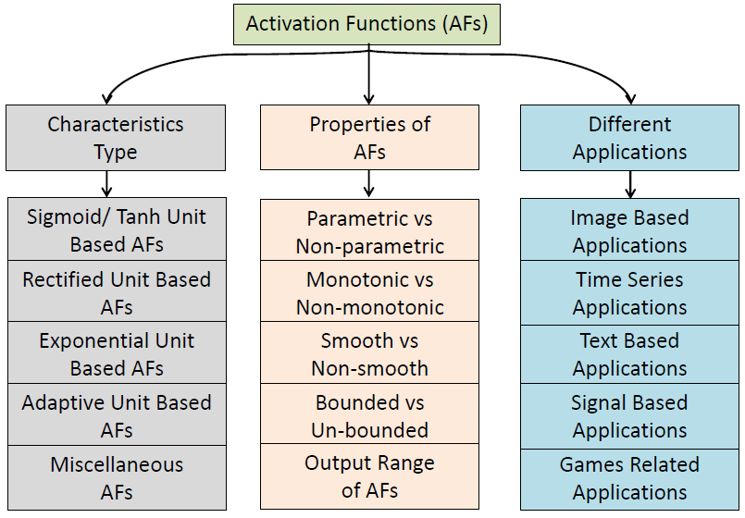
Activation Functions: Classification
Activation Functions in Deep Learning: A Comprehensive Survey and Benchmark, Shiv Ram Dubey, Satish Kumar Singh, and Bidyut Baran Chaudhuri, Neurocomputing, 503:92-108, Sept 2022. (Elsevier)

Slide 33
Activation Functions: IN Practice
Use ReLU. Be careful with your learning rates
Try out PDELU/ABReLU/Swish/
Try out Leaky ReLU but performance might not be stable
Try out tanh but don’t expect much
Don’t use sigmoid

Slide 34
Acknowledgement
Deep Learning, Stanford University
Introduction to Deep Learning, University of Illinois at Urbana-Champaign
Introduction to Deep Learning, Carnegie Mellon University
Convolutional Neural Networks for Visual Recognition, Stanford University
Natural Language Processing with Deep Learning, Stanford University
NVDIEA Deep Learning Teaching Kit

